Slide 1
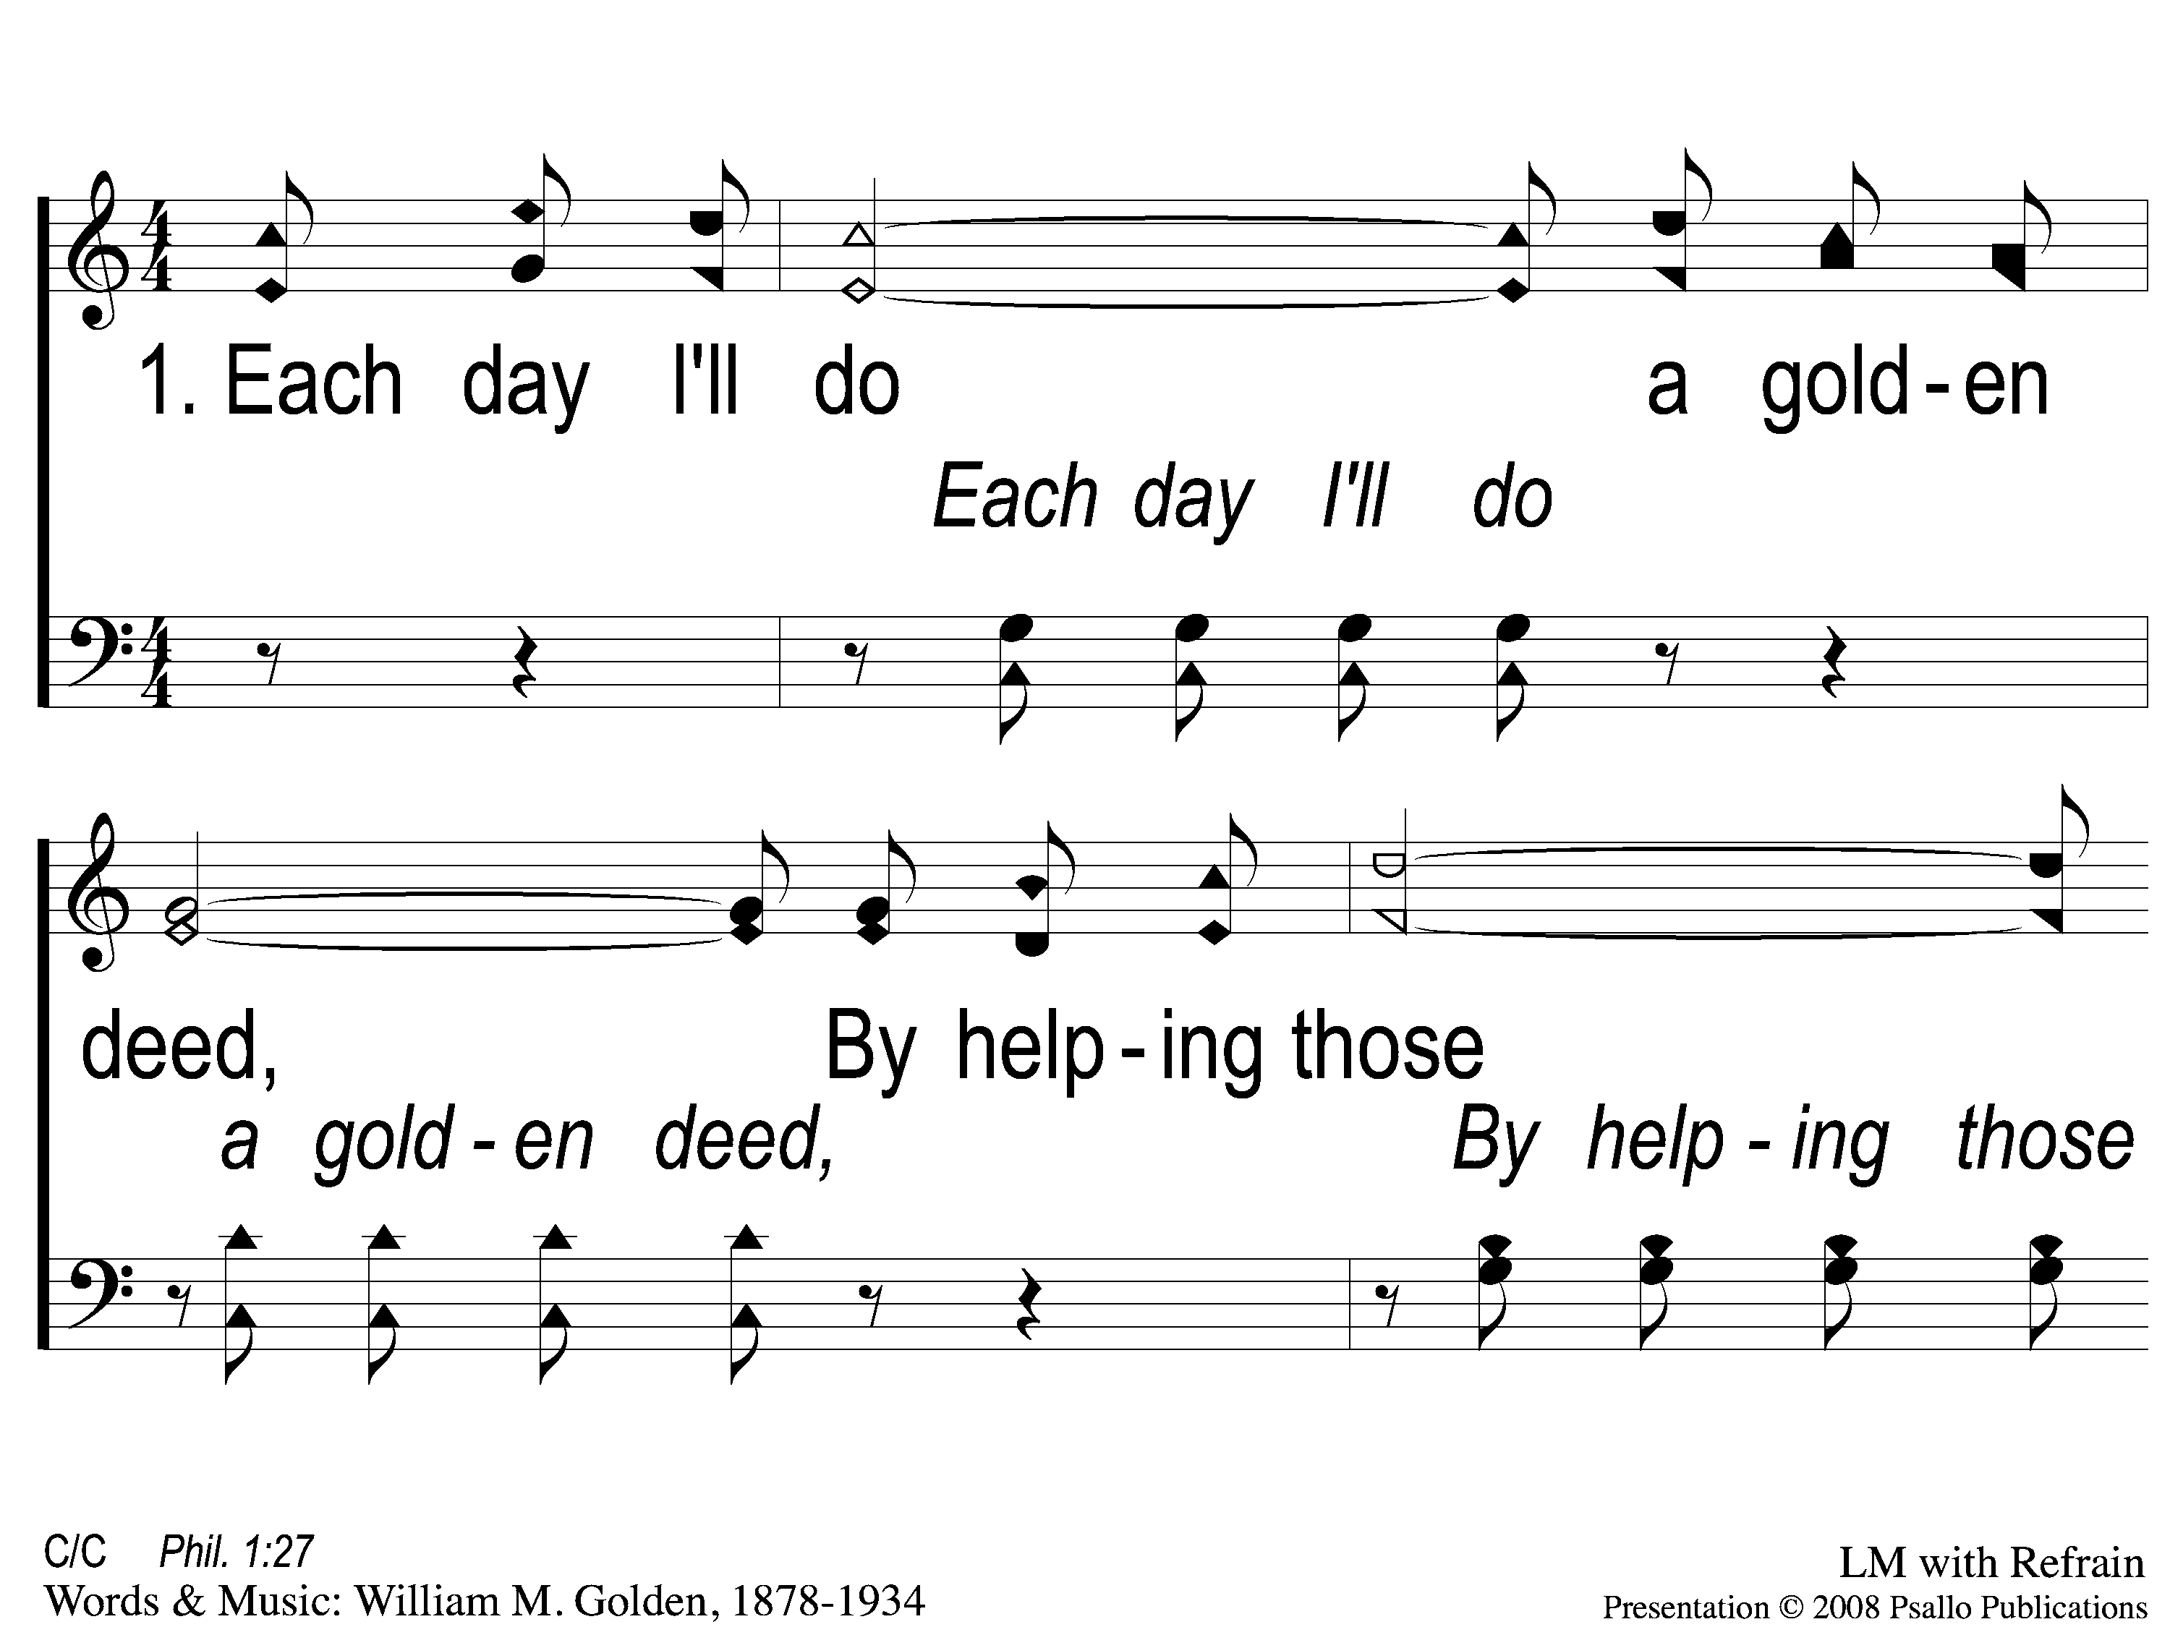
1-1 A Beautiful Life
A Beautiful Live
9

Slide 2
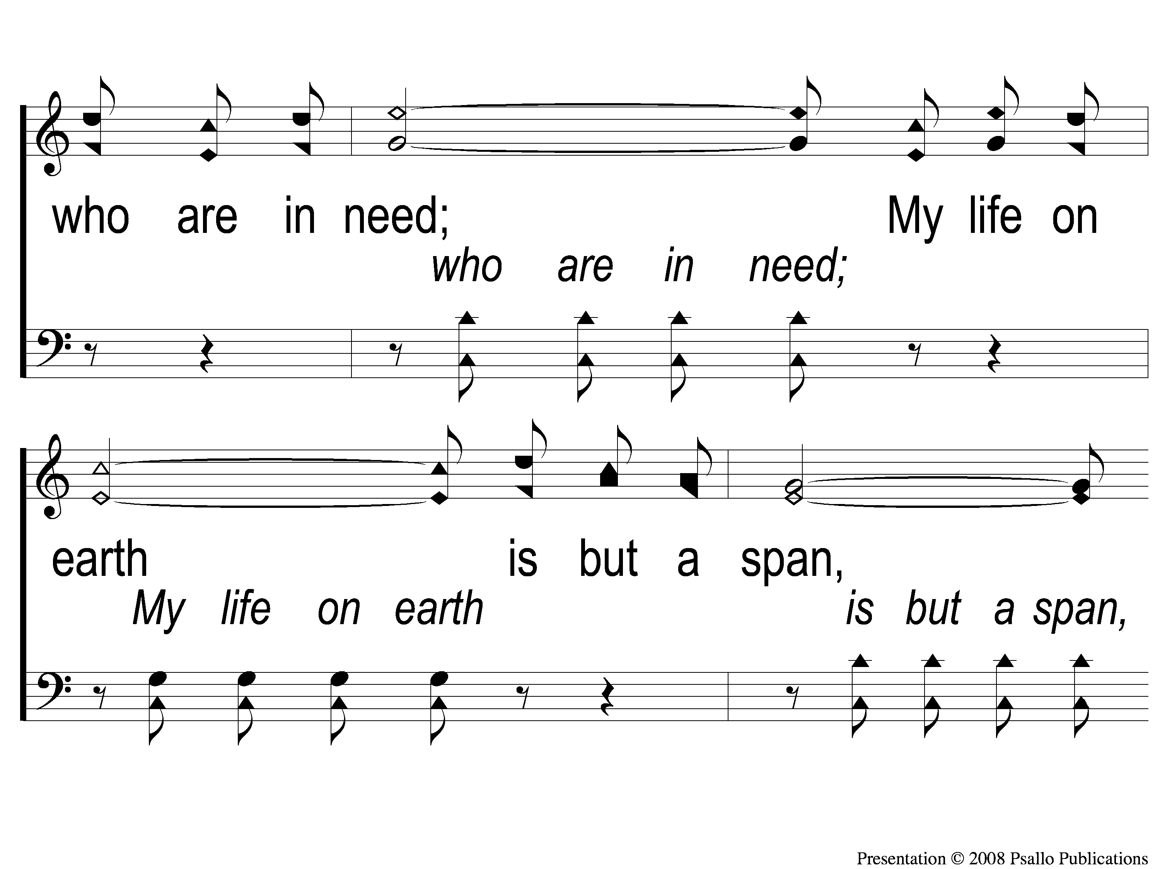
1-2 A Beautiful Life
A Beautiful Live
9

Slide 3
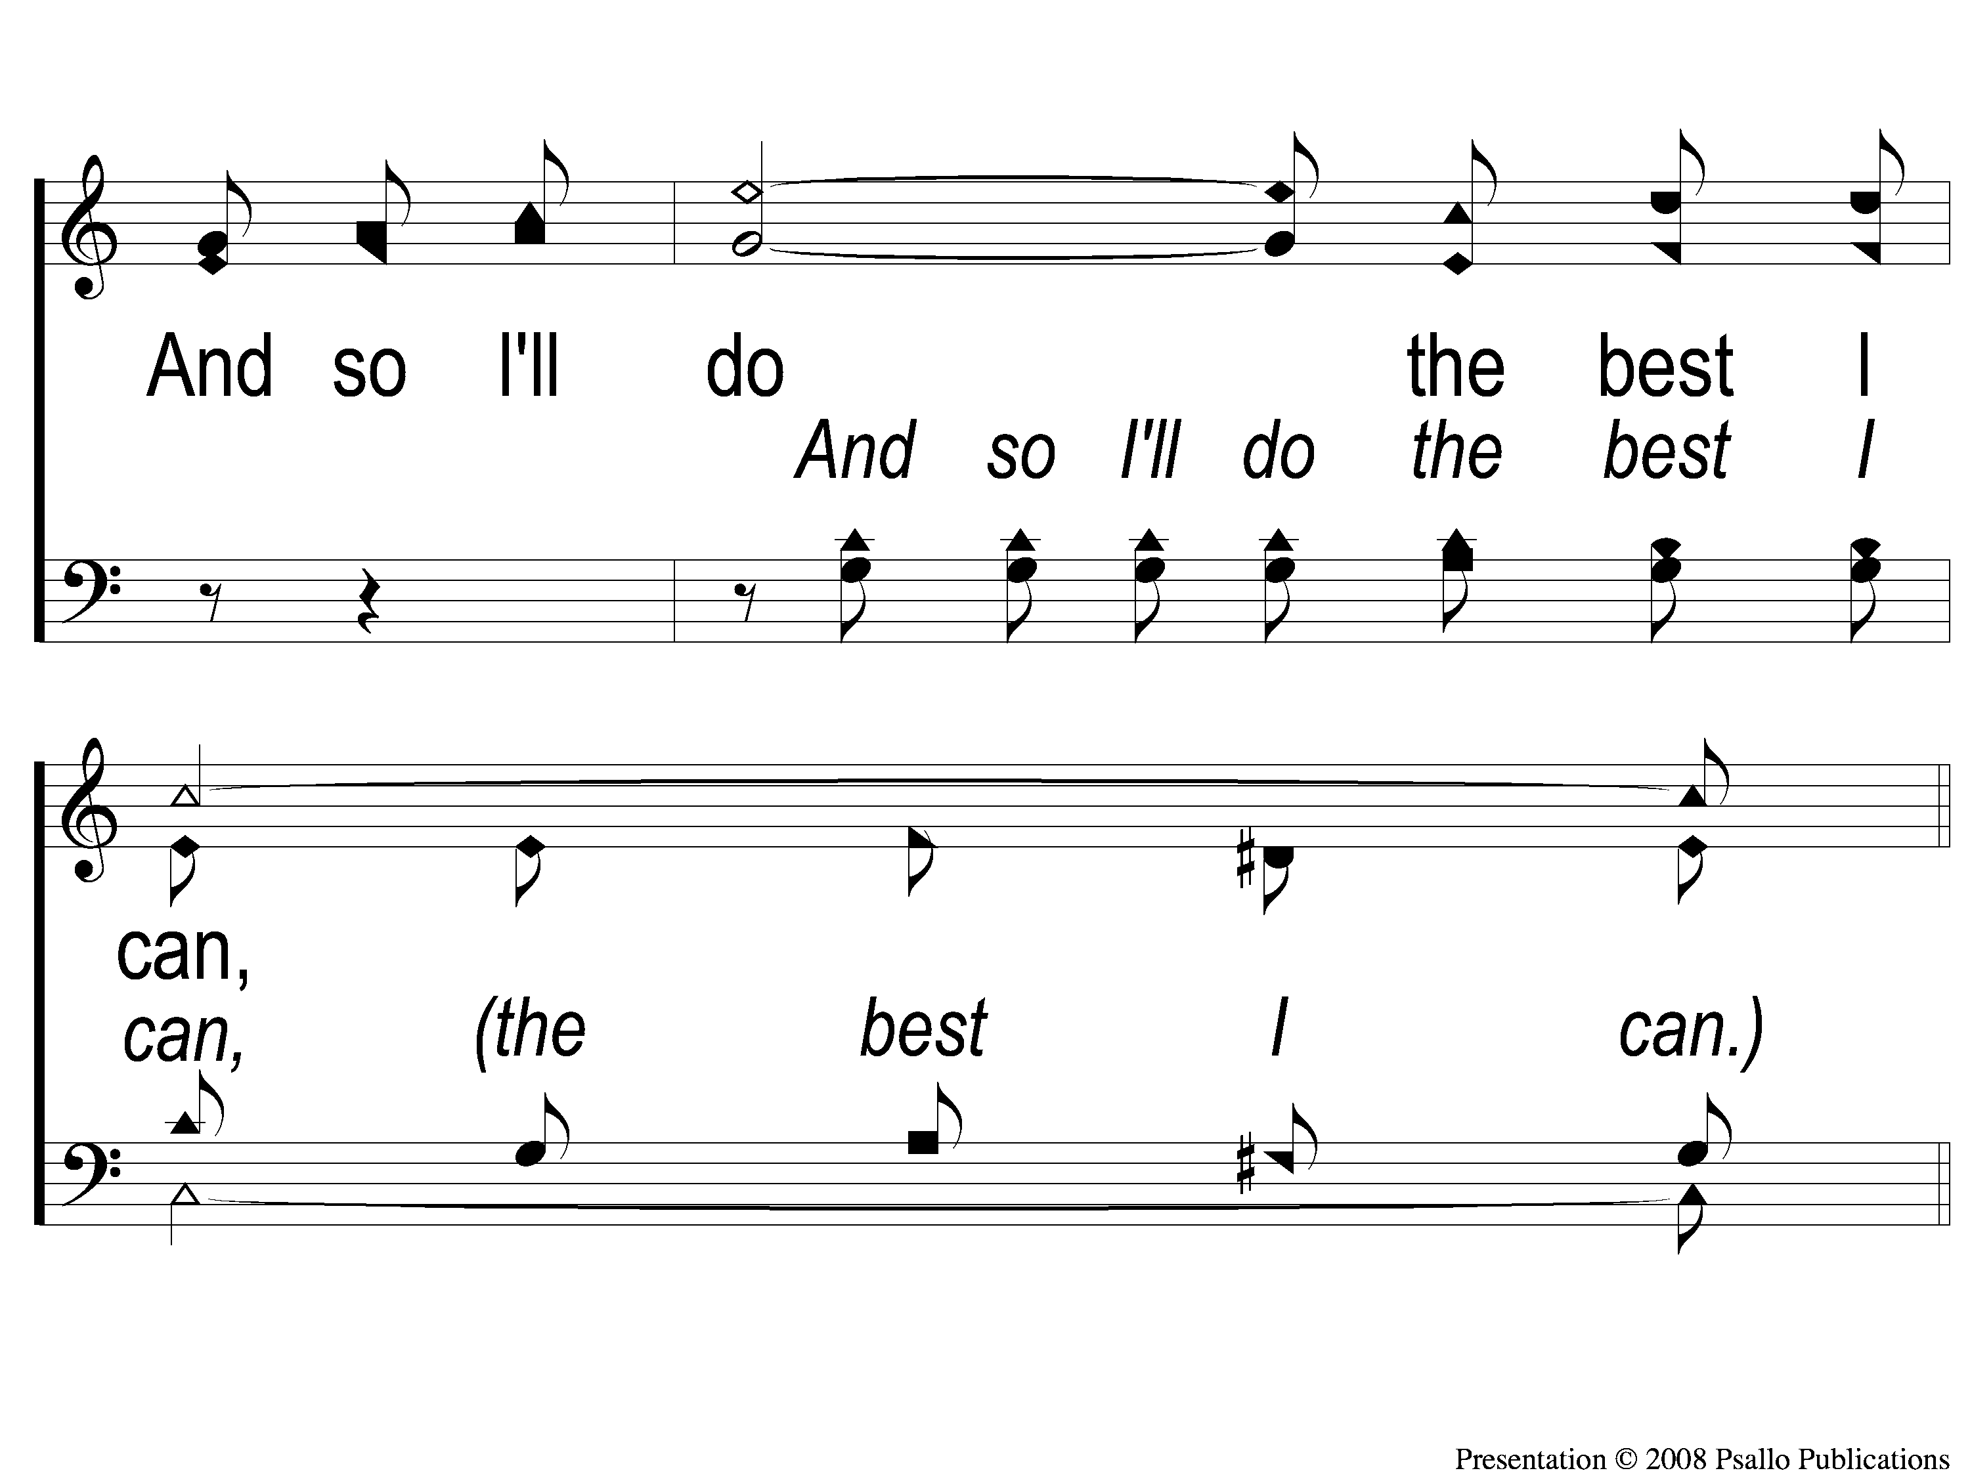
1-3 A Beautiful Life
A Beautiful Live
9

Slide 4
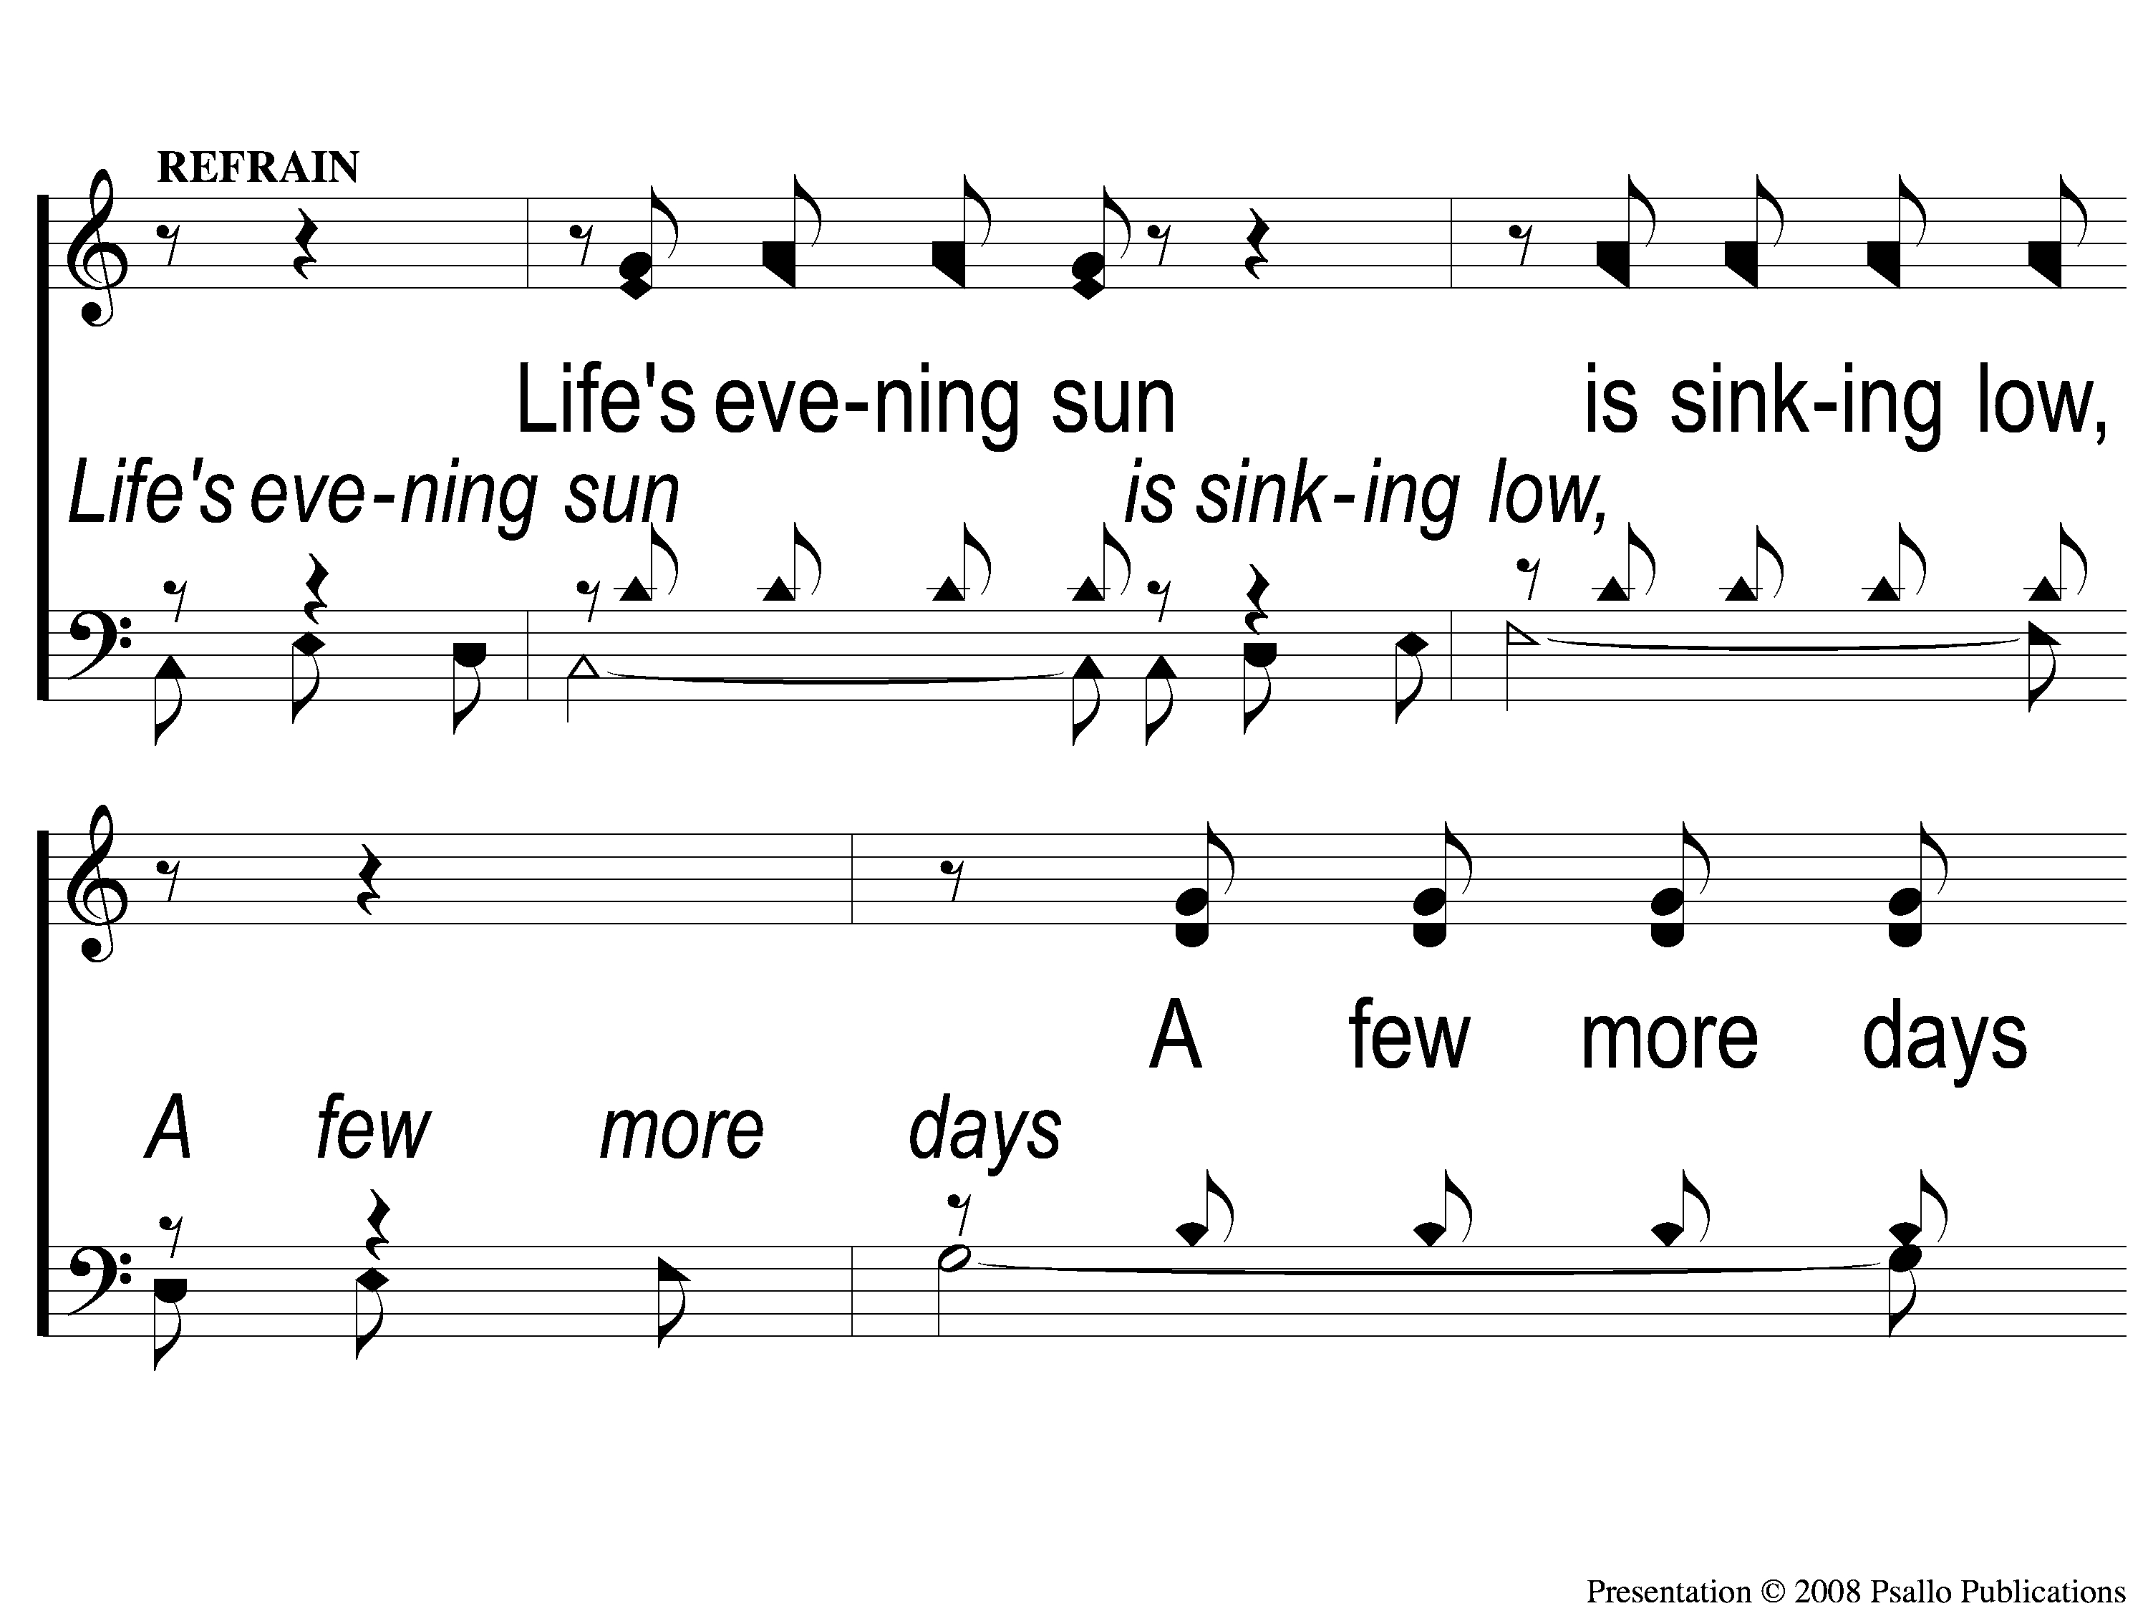
C-1 A Beautiful Life
A Beautiful Live
9

Slide 5
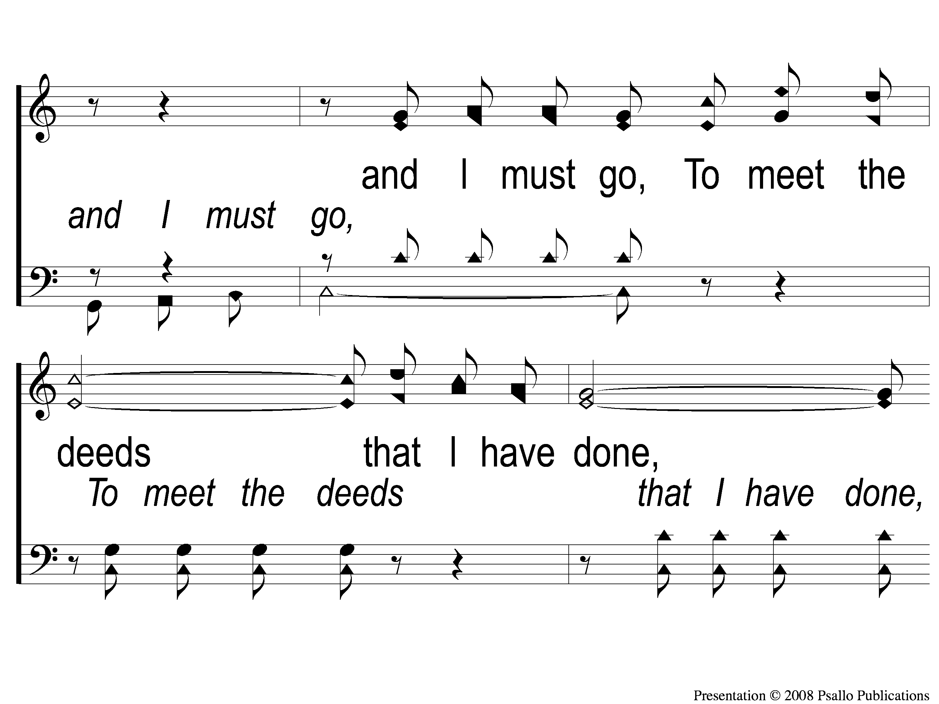
C-2 A Beautiful Life
A Beautiful Live
9

Slide 6
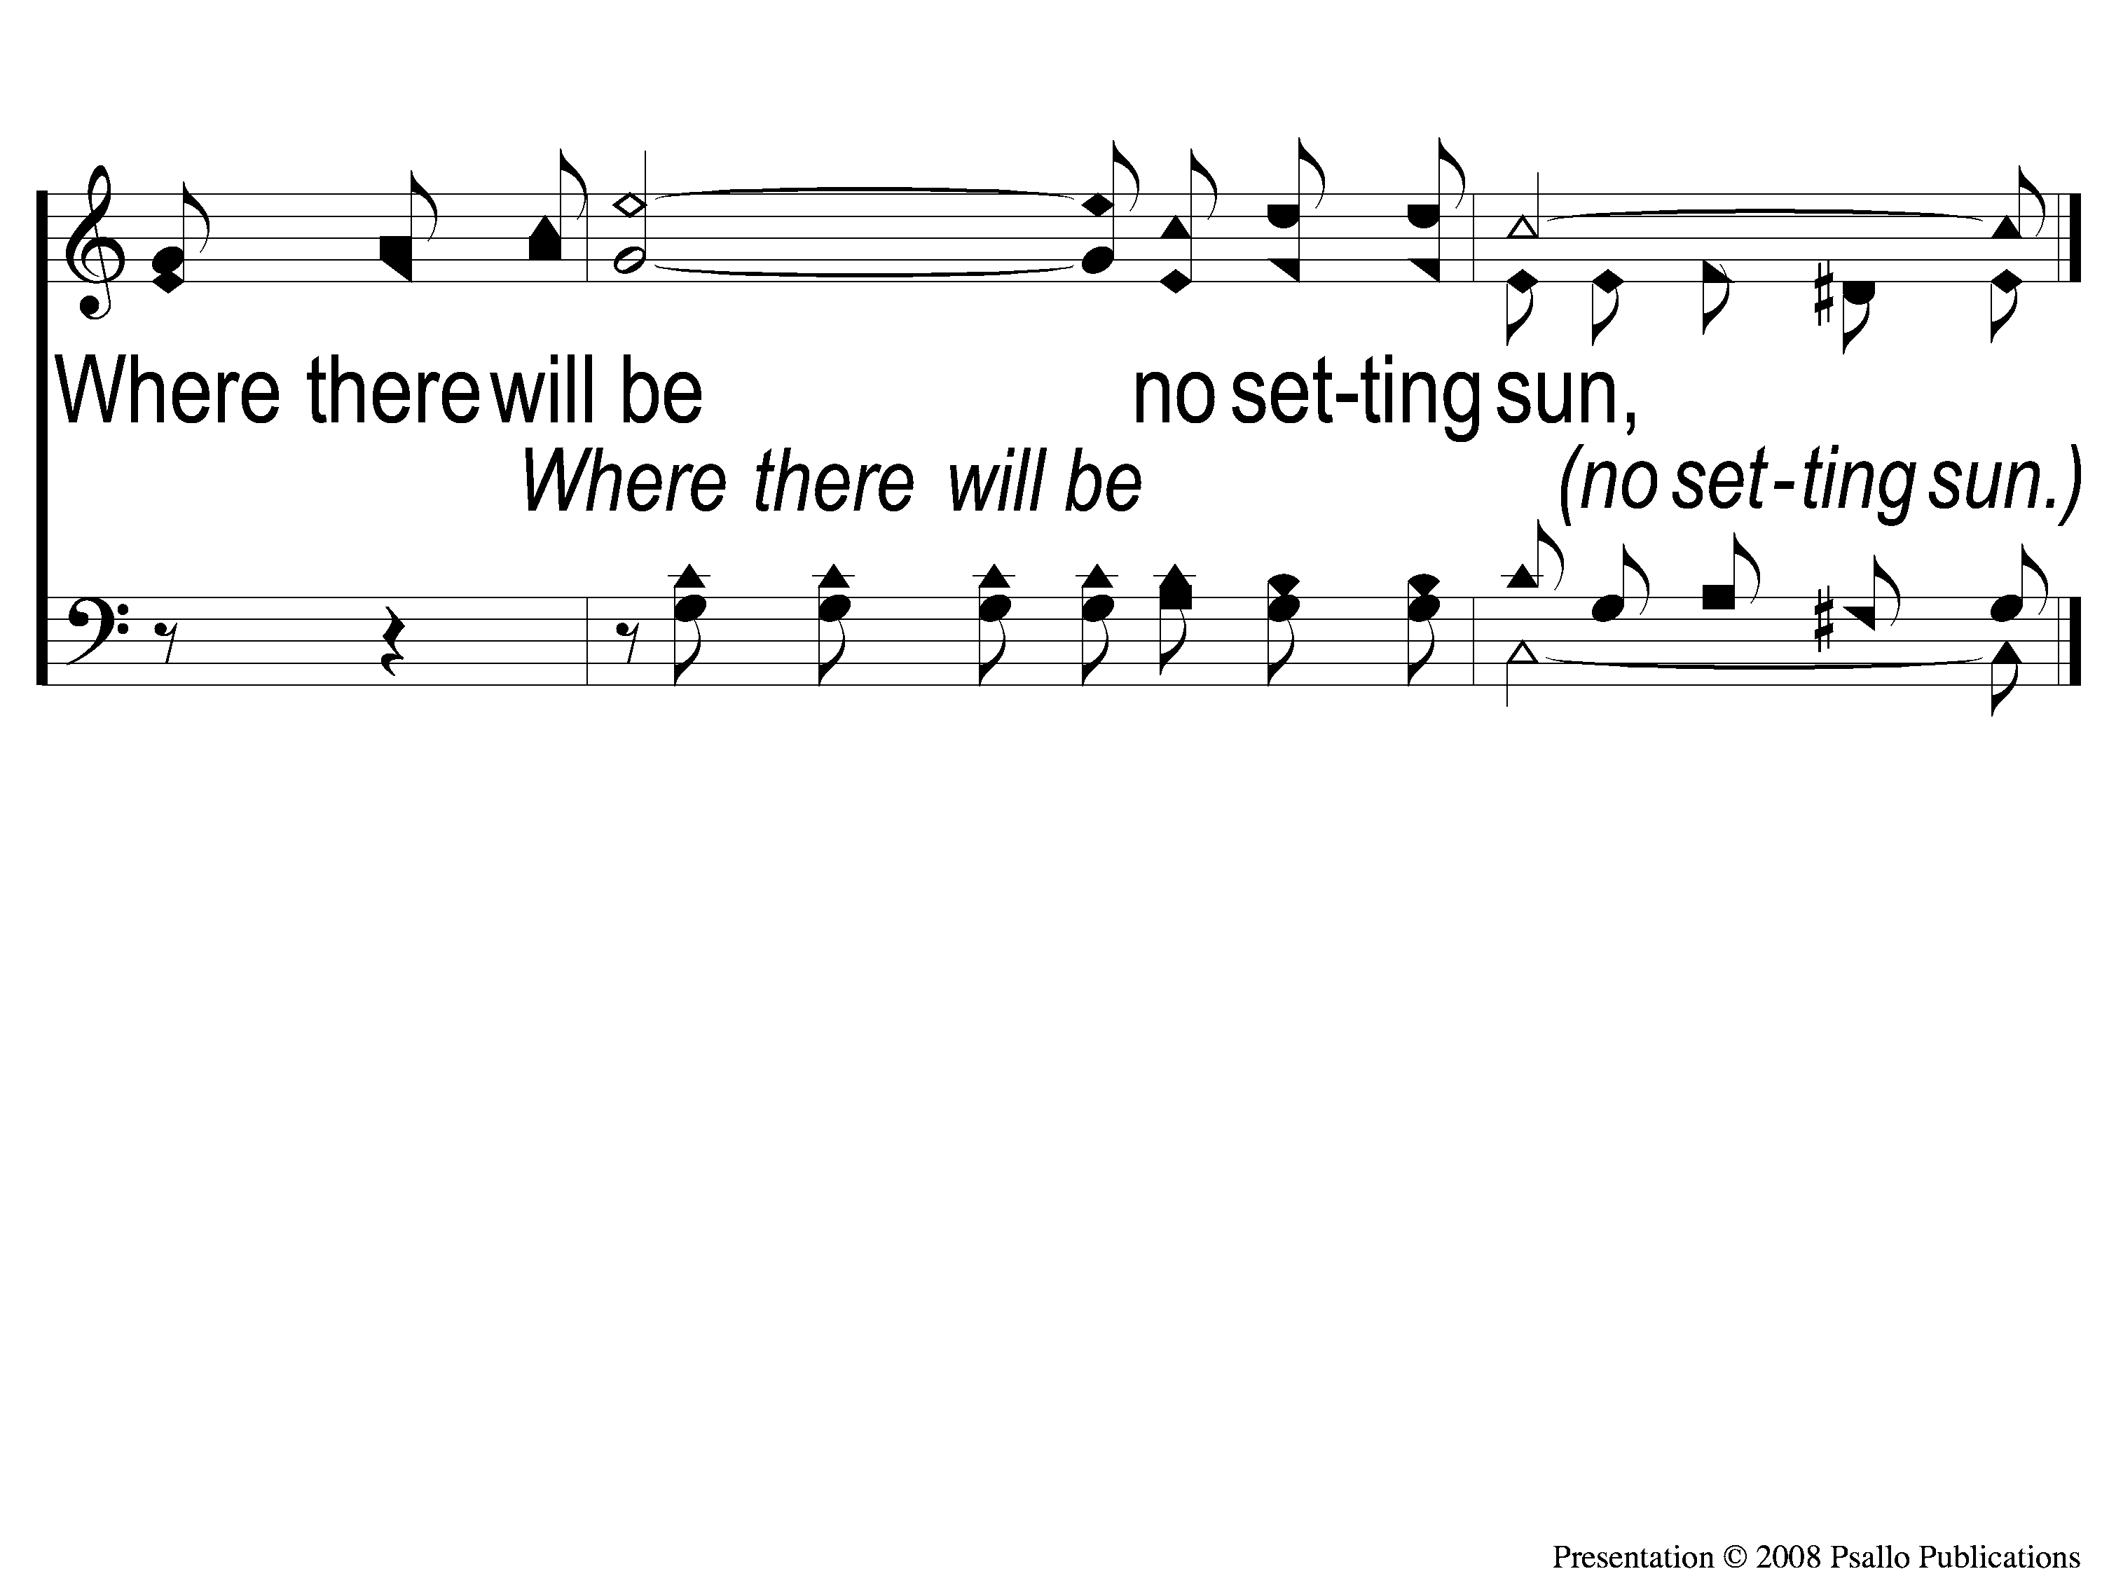
C-3 A Beautiful Life
A Beautiful Live
9

Slide 7
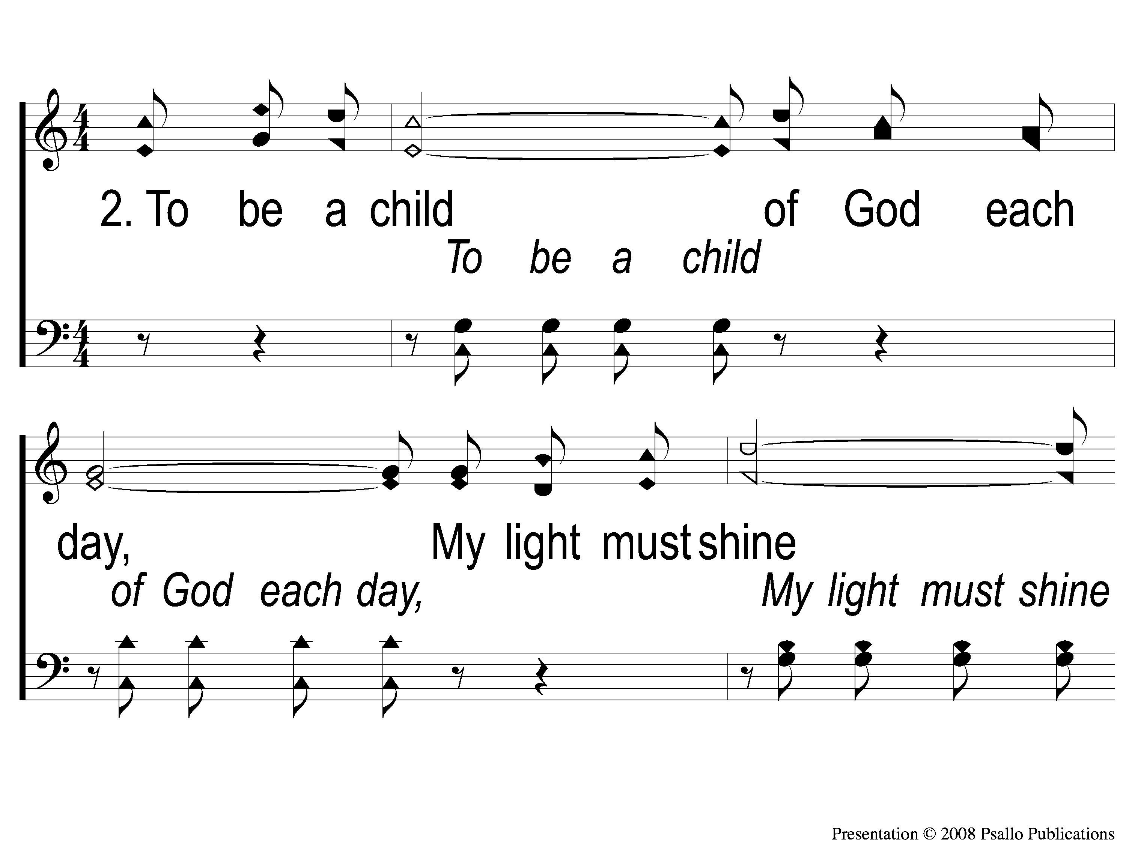
2-1 A Beautiful Life
A Beautiful Live
9

Slide 8
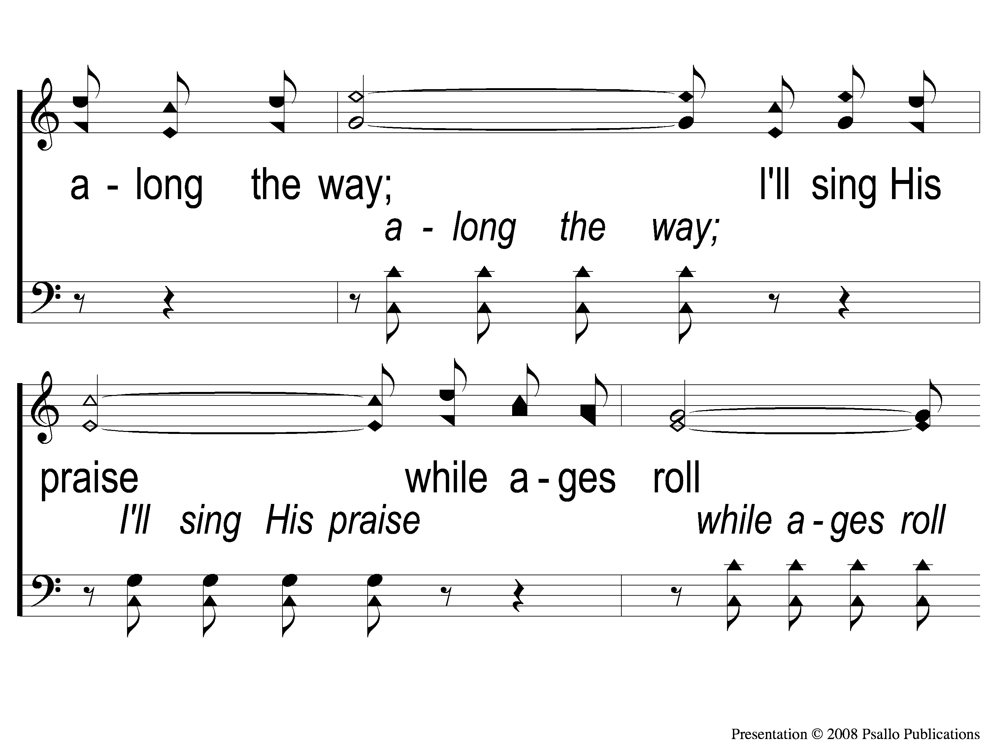
2-2 A Beautiful Life
A Beautiful Live
9

Slide 9
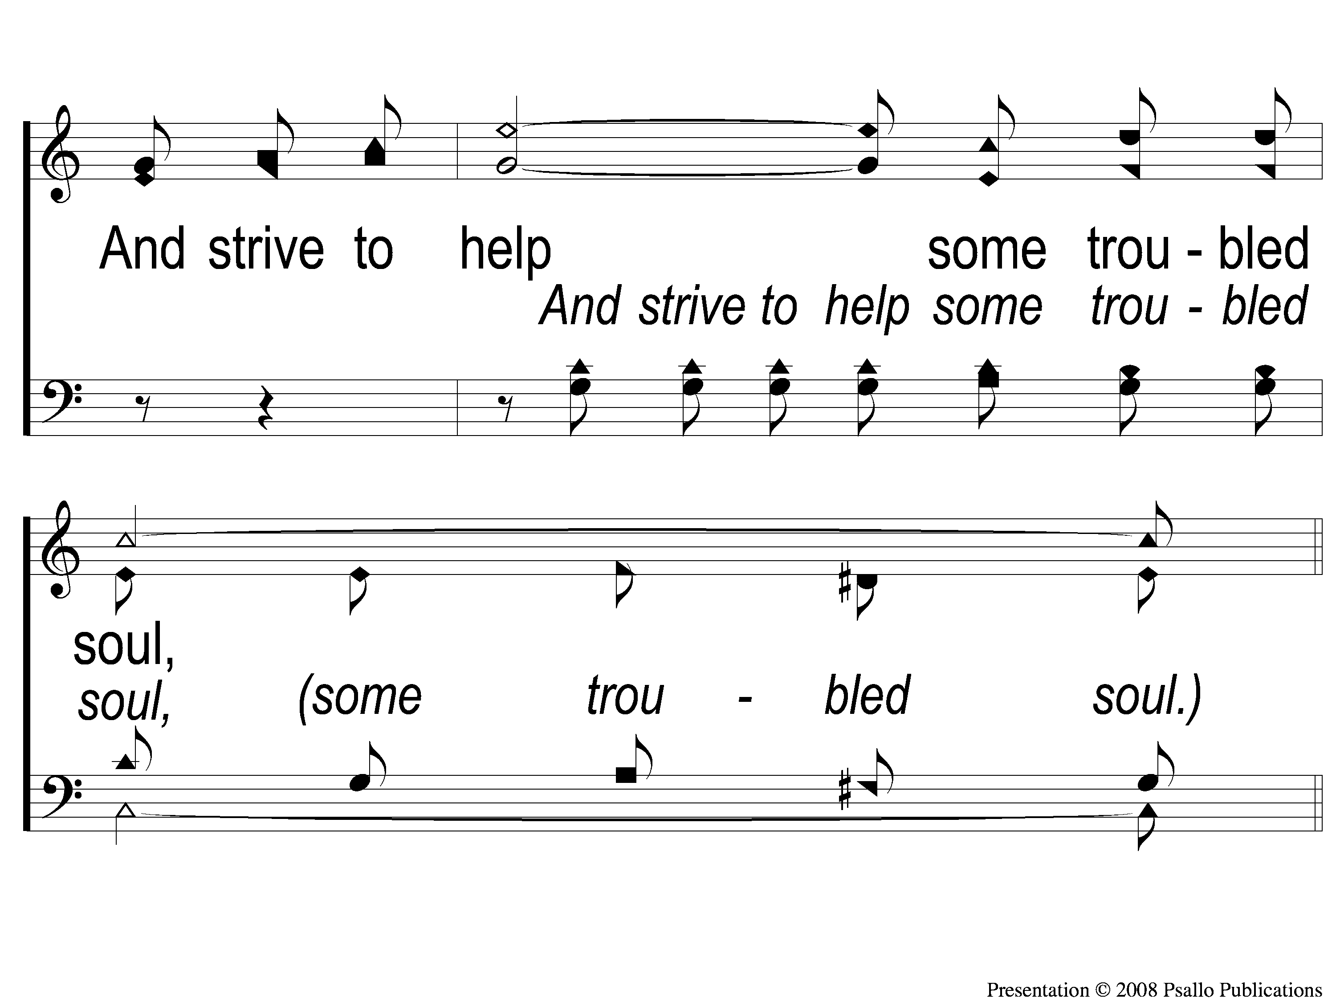
2-3 A Beautiful Life
A Beautiful Live
9

Slide 10
C-1 A Beautiful Life
A Beautiful Live
9

Slide 11
C-2 A Beautiful Life
A Beautiful Live
9

Slide 12
C-3 A Beautiful Life
A Beautiful Live
9

Slide 13
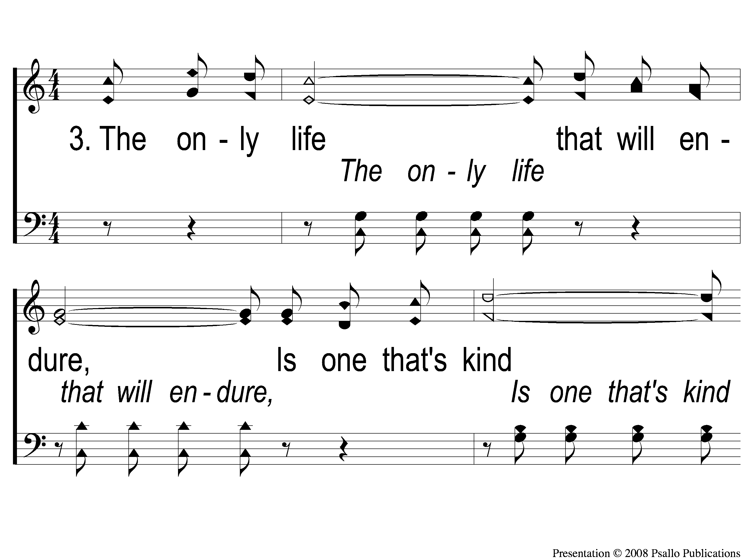
3-1 A Beautiful Life
A Beautiful Live
9

Slide 14
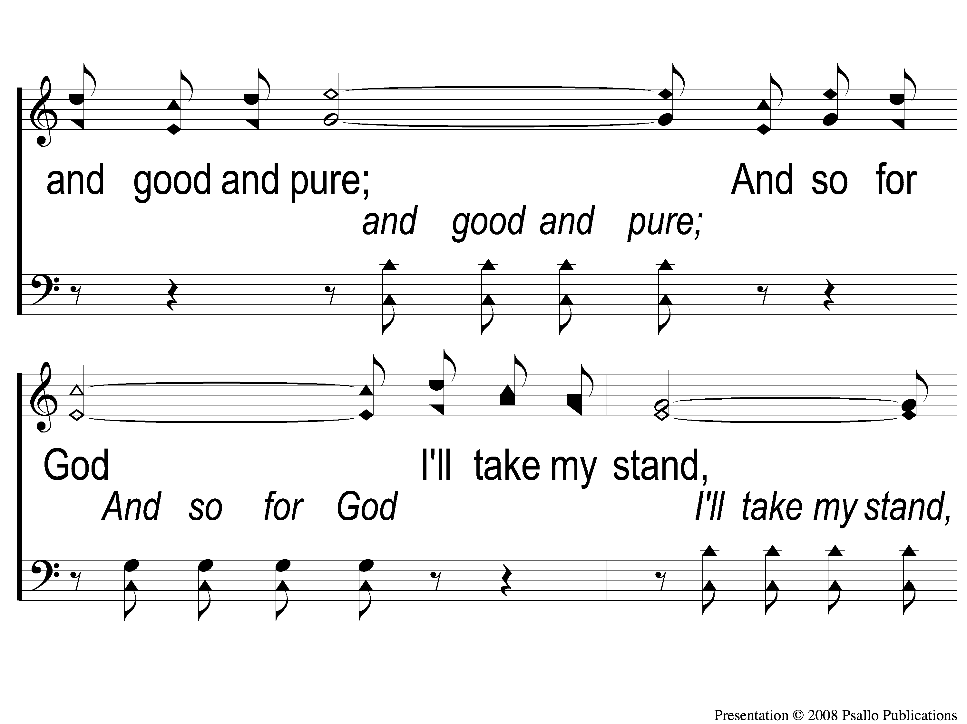
3-2 A Beautiful Life
A Beautiful Live
9

Slide 15
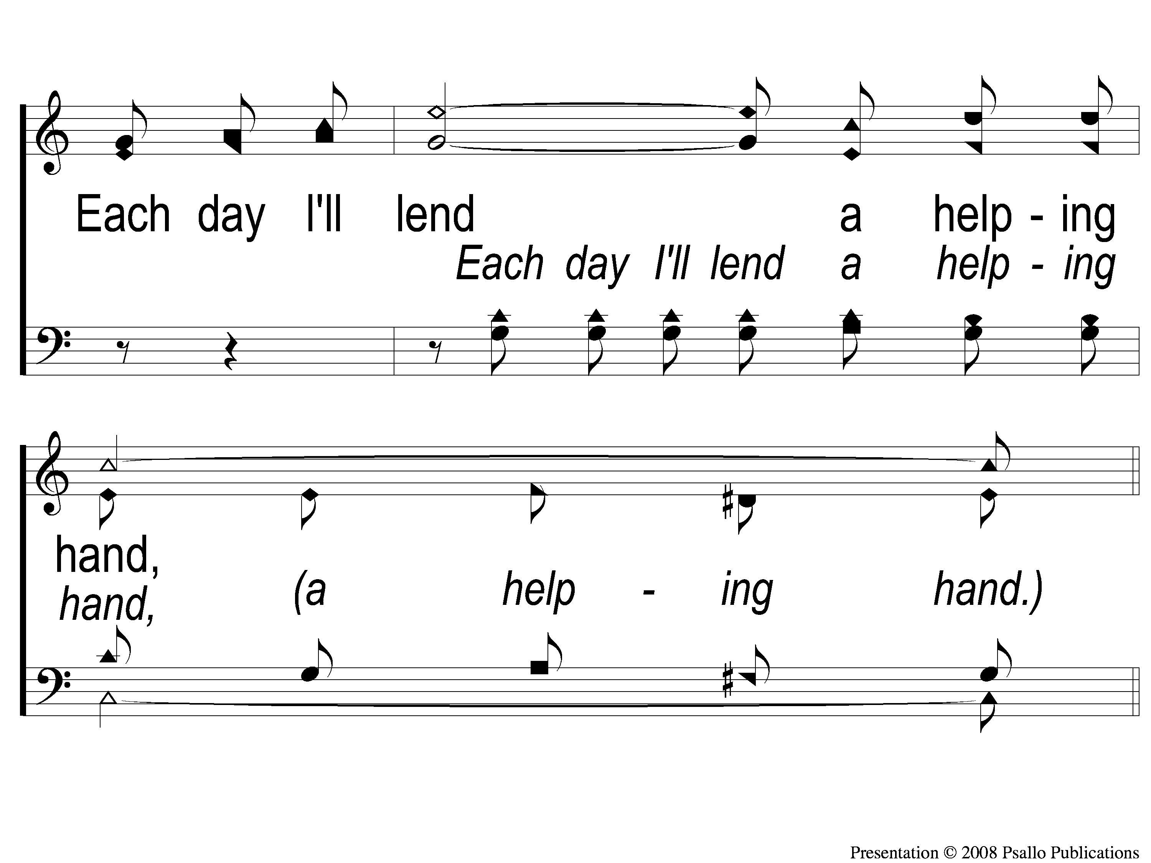
3-3 A Beautiful Life
A Beautiful Live
9

Slide 16
C-1 A Beautiful Life
A Beautiful Live
9

Slide 17
C-2 A Beautiful Life
A Beautiful Live
9

Slide 18
C-3 A Beautiful Life
A Beautiful Live
9

Slide 19
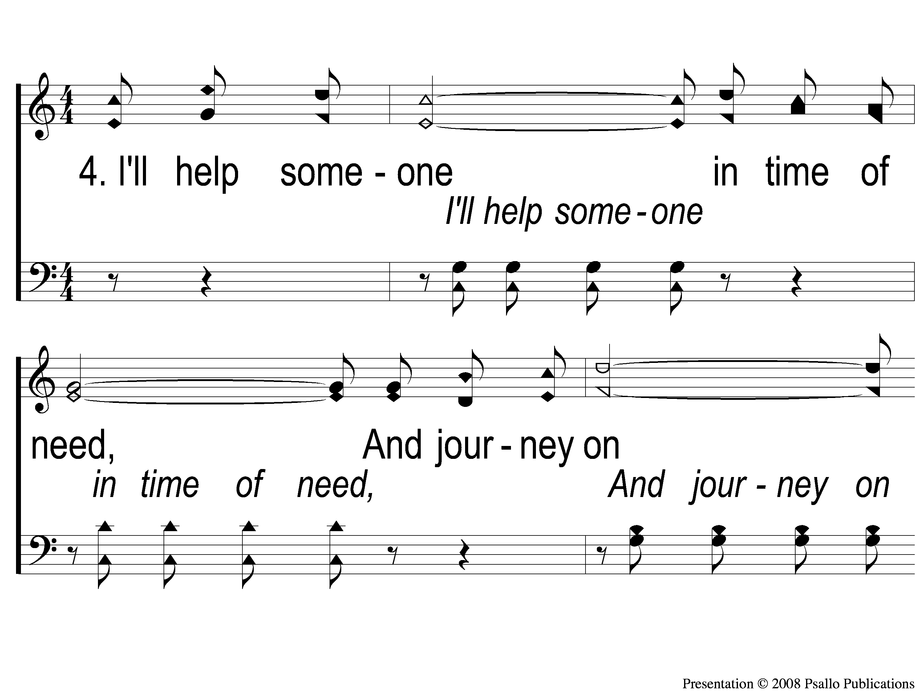
4-1 A Beautiful Life
A Beautiful Live
9

Slide 20
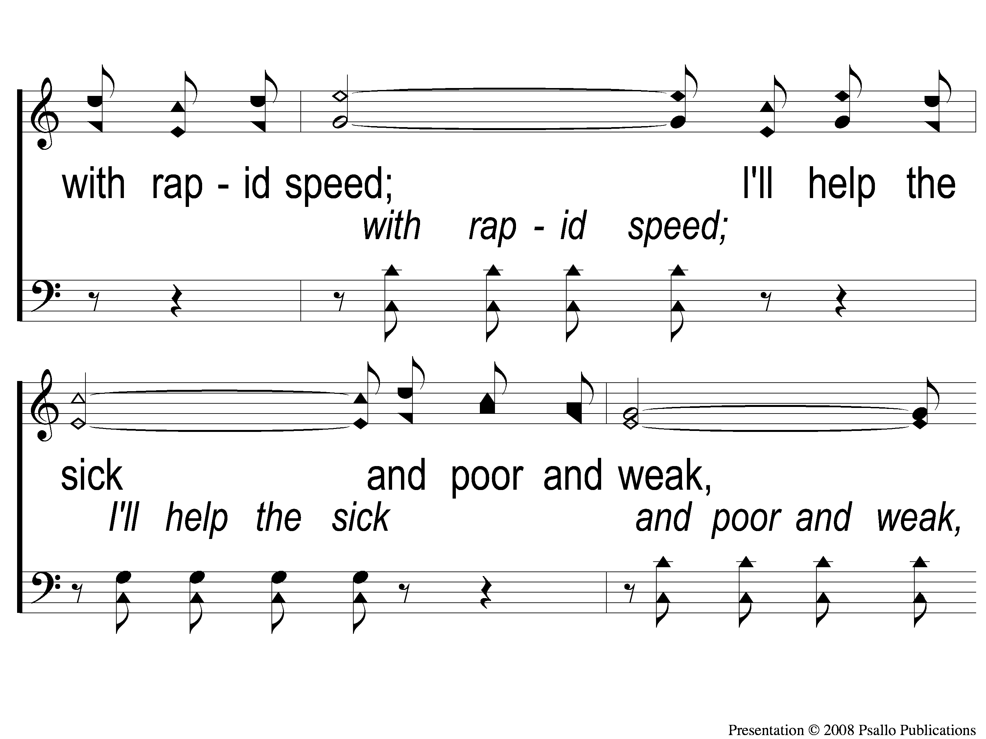
4-2 A Beautiful Life
A Beautiful Live
9

Slide 21
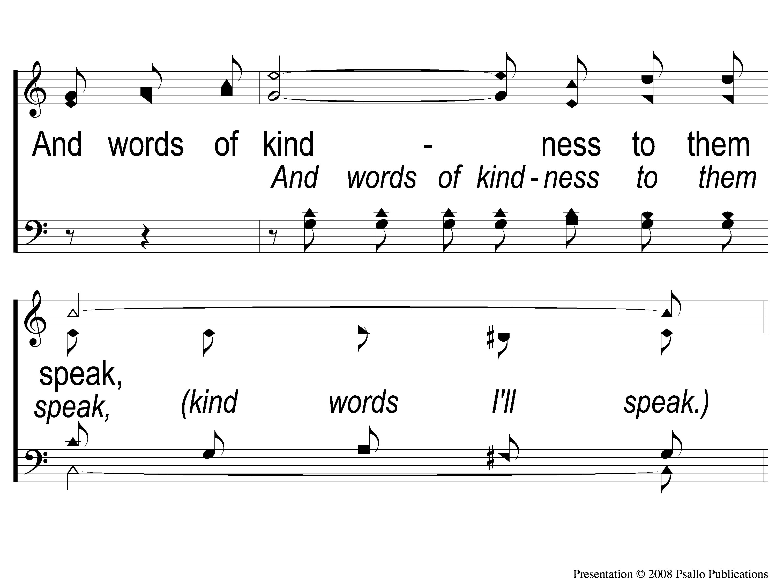
4-3 A Beautiful Life
A Beautiful Live
9

Slide 22
C-1 A Beautiful Life
A Beautiful Live
9

Slide 23
C-2 A Beautiful Life
A Beautiful Live
9

Slide 24
C-3 A Beautiful Life
A Beautiful Live
9

Slide 25
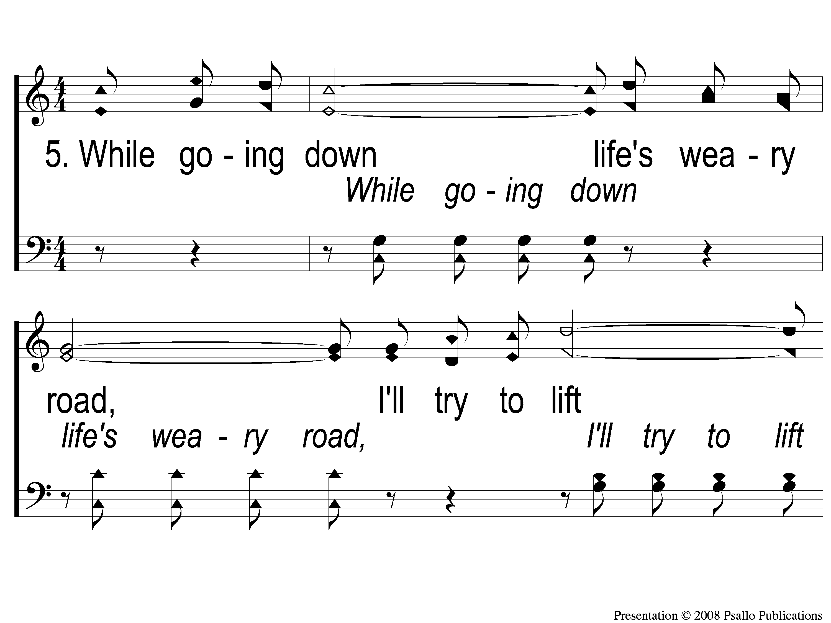
5-1 A Beautiful Life
A Beautiful Live
9

Slide 26
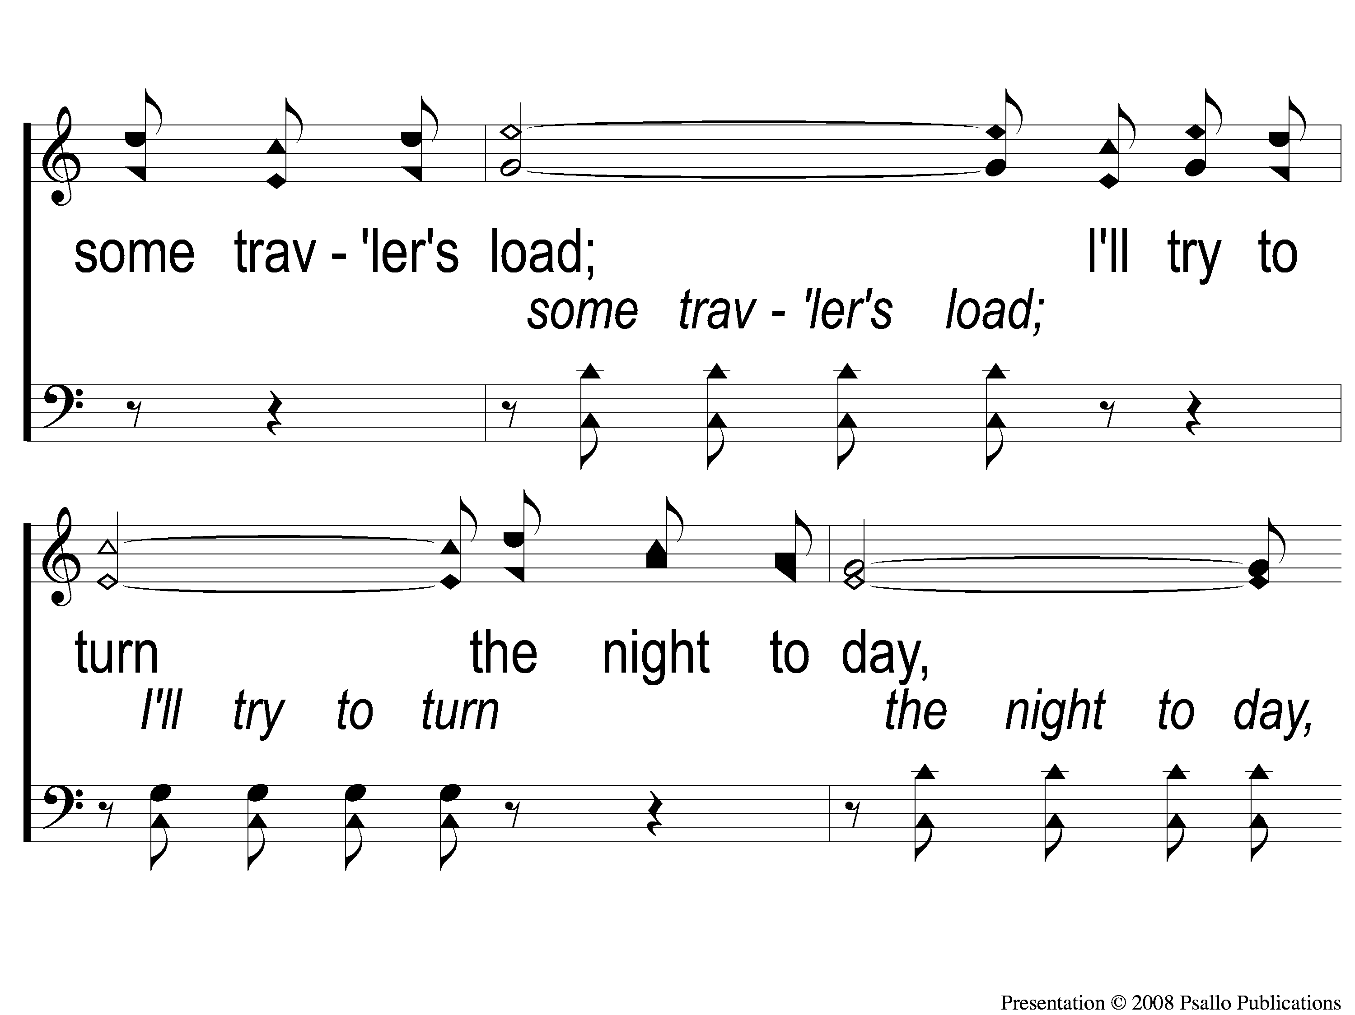
5-2 A Beautiful Life
A Beautiful Live
9

Slide 27
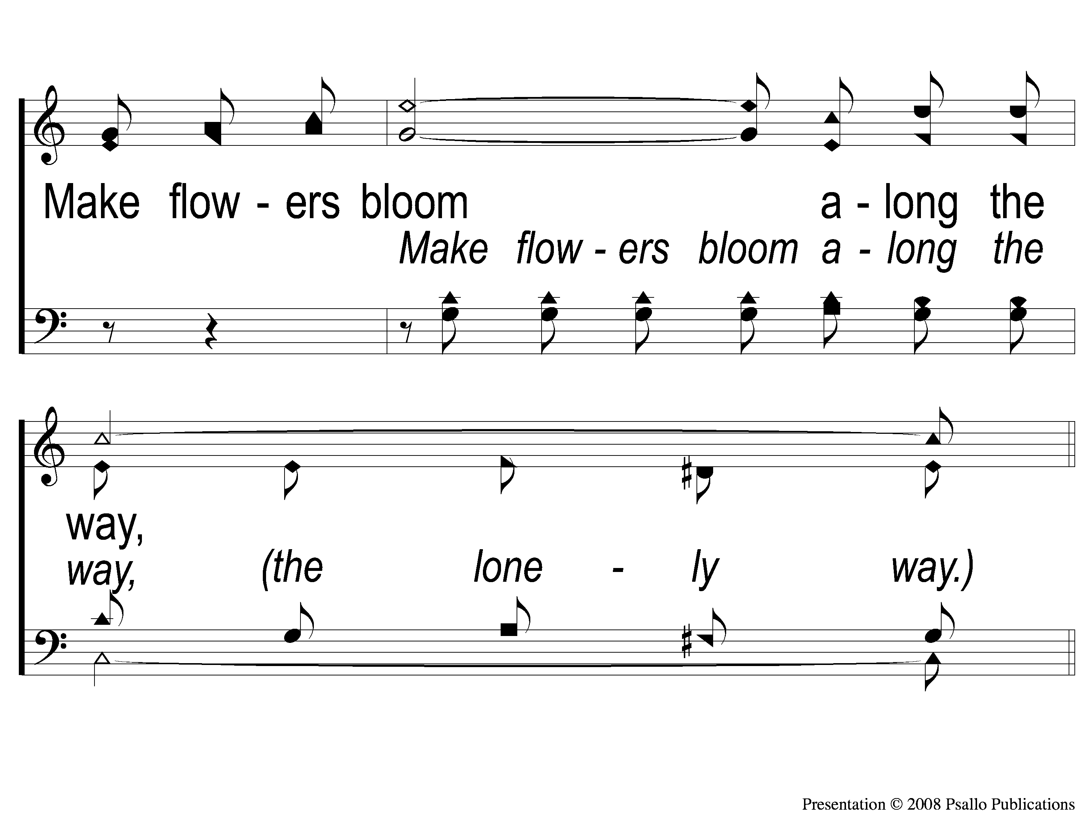
5-3 A Beautiful Life
A Beautiful Live
9

Slide 28
C-1 A Beautiful Life
A Beautiful Live
9

Slide 29
C-2 A Beautiful Life
A Beautiful Live
9

Slide 30
C-3 A Beautiful Life
A Beautiful Live
9

